Slide 1
New Jersey Counts 2020
Presenter:
Ms. Cuqui Rivera
Programs & Outreach Coordinator
The Latino Action Network Foundation (LANF) is established as a charitable organization with the goal of uniting New Jersey’s diverse Latino communities and advancing our economic and social empowerment.

Slide 2
Overview An accurate 2020 Census is essential for New Jersey
Funding: $22B relies on the Census
Data: Programs rely on Census data for planning
Representation: Political districts determine by Census data
NJ has high numbers of “hard-to-count” groups, such as young children, renters, racial/ethnic minorities and immigrant households
Government, non-profits, business and community organizations can help NJ have an accurate 2020 Count

Slide 3
What is the Census?
Essential Constitutional requirement every 10 years
Counts every living person in the United States
Run by the Federal Census Bureau

Slide 4
Why does the Census matter?
Funding: $675 billion in federal funds depend on Census
($22B in New Jersey!)
Planning Data: Number of hospital beds or school classrooms; new business branches; roads/highways
Representation: Census data determines district boundaries and how many representatives states get in Congress
Community: Census tells us who our communities and neighbors are

Slide 5
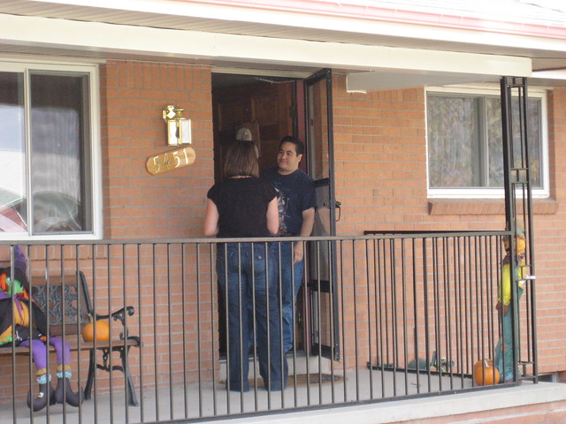
How do people fill out the census?
Four ways….
Online (new preferred method)
Phone
Mail
In-Person (door-knocking)

Slide 6
Special challenges in 2020
First Census to be primarily filled out online or on the phone
15% of NJ residents have no internet or land lines
(No cell phones)
Distrust of government and polls/surveys
Less Census staff than 2010 for in-person follow-up and coordination

Slide 7
Census language support is critical
31% of New Jersey residents speak a language other than English at home
Online and phone will be available in 12 languages
Spanish, Chinese (Mandarin & Cantonese), Vietnamese, Korean, Russian, Arabic, Tagalog, French, Haitian Creole, Polish, Portuguese, Japanese
Hard-copy mail form only available in English and Spanish

Slide 8
What census asks for
Basic identification information
Who lives here (name, age, gender)
Housing tenure (owner, renter, etc.)
Racial/ethnic or national origin
Family relationships of residents
Data is confidential
Strong Confidentiality Laws Protect All Data the Census: 12-5-19
https://www.brennancenter.org/our-work/analysis-opinion/strong-confidentiality-laws-protect-all-data-census-bureau-collects?fbclid=IwAR2pxp0FUrwJRsT-sfkDRPDLNIwQ6OXuPBVX0cL2SOqWk2u4snZq9Iw8_zI
Census will never ask for Social Security numbers, citizenship, credit card info, tax ID numbers

Slide 9
Hard-to-count populations
If the Census is so important, why doesn’t everybody fill it out?
Hmmm….

Slide 10
Many reasons for undercount
Address not listed
Multi-unit buildings
People not included on questionnaire
Complex households
Highly mobile populations
Census determined by “usual place of residence” on April 1, 2020
Fear of government
Language issues

Slide 11
How can people be missed by census?
Who are “Hard-to-count” populations that are often missed by the Census
Homeless persons | Young children (under age 5) | Black or Hispanic people
Asians or Asian-Americans | Males ages 30-49 | Renters
Low-income households | Those who don’t speak English well | No internet access
Veterans | Immigrants | Migrant or highly mobile groups

Slide 12
Why is it a problem for NJ?
NJ has high #s of hard-to-count groups
Extremely diverse state (45% non-white, #11 in nation)
High immigrant population (#3 in nation by %)
Concentrated low-income communities
There’s less trust in “official” sources and more trust in local trusted messengers

Slide 13
Where are NJ’s hard-to-count populations?
Mostly NJ’s denser communities
But hard-to-count populations are throughout the state!
Urban core (Newark, Jersey City, Paterson)
But also fast-growing communities (Lakewood, Hudson County)
And rural or spread-out areas (Salem and Cumberland County)

Slide 14
2. Integrate census promotion into your work
Include Census outreach hiring and promotion in grant applications (12,000 will be hired in NJ)
Build Census promotion into existing programs such as health clinics, afterschool activities, government outreach
Spread the word on Census to local networks in hard-to-count communities

Slide 15
1. Participate in local complete count efforts
Encourage your local government to create a Complete Count Committee Ensure that your local CCC has representation from Hard-to-Count communities
Educate local groups of parents, families and organizations on the importance of Census
Partner with Census Bureau to provide information to families and community members
Email Partnership Specialist: Patricia.R.Greene.Alston@2020census.gov

Slide 16
Communicate importance of census
Multiple sources and multiple points
Non-traditional media (social media, local newsletters)
Non-English media (newspapers, radio)
Earned media (news stories, op-eds)
Schools and government
Modeled on health insurance and get-out-the-vote
Engage local and state elected officials to amplify your Census messaging to their networks

Slide 17
Some more ideas of who can help & how..
Marketplace: place signs near formula and diapers reminding people to count young kids in Census
Faith-Based: include information on the importance of Census in sermons or newsletters
Schools, libraries or child care: serve as a Census kiosk with staff to help people fill out Census forms
Immigrant groups: ensure that members who speak native languages apply for Census employment
Higher education: train student volunteers as “Census Ambassadors” to present at local meetings
Local government: ensure that WIC counselors, child care, senior & all referral agencies communicate the importance of Census

Slide 18
Timeline: what to do when
Education
Present on-going education throughout campaign
Partner & sponsor efforts w Census Bureau
Activation
January until April 1, 2020 (Census Day)
Public education workshops
Follow-Up
April (Census Day) until December 2020
Direct canvassing and phone banking
Include Census in funding requests for 2020
Educate staff and secure resources for Census (e.g., computers)
Media messaging for HTC communities
Distribute education materials to families
Census hiring especially non-English-speakers (2020census.gov/jobs)
Cultural competence training for Census follow-up workers
Host Census kiosks with computers
Participate in local Complete Count Committee

Slide 19
Resources
CENSUS Outreach Materials: https://2020census.gov/en/partners/outreach-materials.html
ACNJ Census Page: https://acnj.org/census2020nj/
Partnership for America’s Children: https://countallkids.org/
Leadership Conference: https://civilrights.org/census/
U.S. Census Bureau: https://www.census.gov/partners.html
Maps of Hard-to-Count areas: https://www.censushardtocountmaps2020.us/
Peter Chen: PChen@ACNJ.Org
Cuqui Rivera Cuqui@LANFoundation.Org

Slide 20
THANK YOU!!!!

